Slide 1
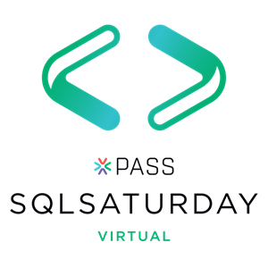





#1000 Oregon

Slide 2
Database performance woes?
Ask for help!
Your local Microsoft Partners and consultants are here to help
Marquam’s SQL Server Assessment provides tuning, optimization, migration, and cloud readiness guidance
Contact: info@marquam.com

Slide 3
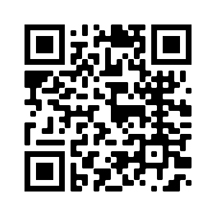
Want to provide feedback on the presentation?
https://www.surveymonkey.com/r/PSKT9VC

Slide 4


Notebooks 101 for SQL People
SQL Saturday #1000 Oregon Oct 24, 2020
Julie Koesmarno (@MsSQLGirl)
Program Manager, Microsoft
jukoesma@microsoft.com

Slide 5


2 questions to get us started…
https://pollev.com/juliek820

Slide 6
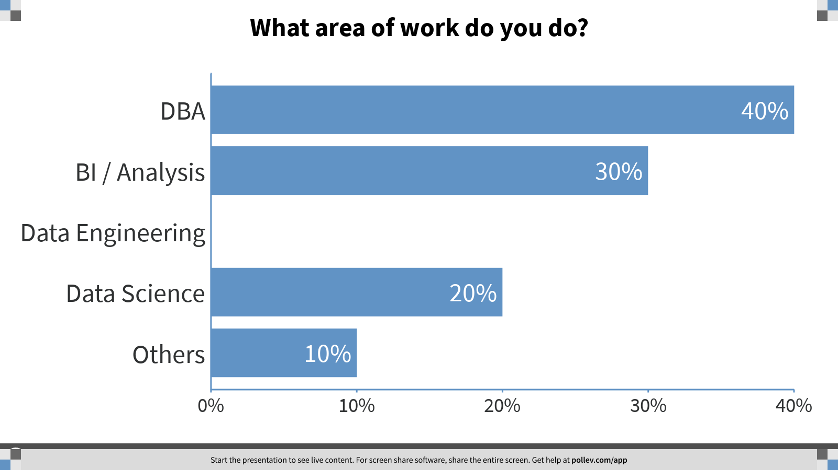

Slide 7
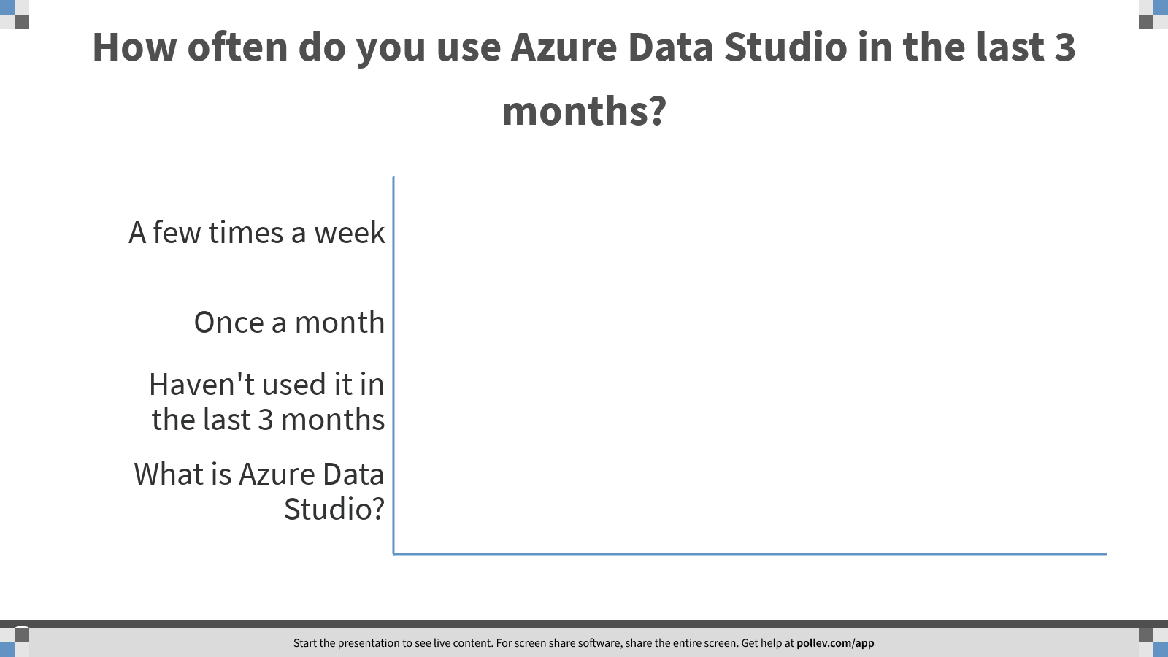

Slide 8
follow along? aka.ms/getAzureDataStudio github.com/MsSQLgirl/jubilant-data-wizards

Slide 9

1. why notebooks?

Slide 10



--
-- Prepared by Cookie Monster
-- 2020.03.01
-- Question from Marketing about how much we sell and what's the shorter manufacturing time.
--
SELECT TOP 10 *
FROM Production.Product
ORDER BY Name ASC;
I need to know which product has the fastest turnaround ..
Let me query that!
Here you go…
Oh.. I need the product category..
-- Get Product list and product category with fast manufacture days
USE AdventureWorks2017;
GO
SELECT
c.Name AS ProductCategory
, p.Name as ProductName
, p.ProductNumber
, p.ListPrice AS Price
, p.DaysToManufacture
FROM Production.Product p
INNER JOIN Production.ProductSubcategory s
ON s.ProductSubcategoryID = p.ProductSubcategoryID
INNER JOIN Production.ProductCategory c
ON c.ProductCategoryID = s.ProductCategoryID
WHERE p.DaysToManufacture < 4
GO
-- Get Product List with fast manufacture days.
SELECT
p.Name as ProductName
, p.ProductNumber
, p.ListPrice AS Price
, p.DaysToManufacture
FROM Production.Product p
WHERE p.DaysToManufacture < 4
GO
Sure..
Here you go again…
1
Thanks! This is for the last quarter, right?
Do you mean sold products?
2

Slide 11

-- Get Product list and product category with fast manufacture days
USE AdventureWorks2017;
GO
SELECT
c.Name AS ProductCategory
, p.Name as ProductName
, p.ProductNumber
, p.ListPrice AS Price
, p.DaysToManufacture
FROM Production.Product p
INNER JOIN Production.ProductSubcategory s
ON s.ProductSubcategoryID = p.ProductSubcategoryID
INNER JOIN Production.ProductCategory c
ON c.ProductCategoryID = s.ProductCategoryID
WHERE p.DaysToManufacture < 4
AND EXISTS (SELECT TOP 1 1
FROM Sales.SalesOrderDetail sod
INNER JOIN Sales.SalesOrderHeader soh
ON soh.SalesOrderID = sod.SalesOrderID
WHERE sod.ProductID = p.ProductID
AND soh.OrderDate BETWEEN '20140101' AND '20140331')
GO
I need to know which product has the fastest turnaround ..
Let me query that!
Here you go…
3
Oh.. I need the product category..
Sure..
Here you go again…
Thanks! This is for the last quarter, right?
Do you mean sold products?
Here you go again…
You are a Rockstar! Thanks.

Slide 12
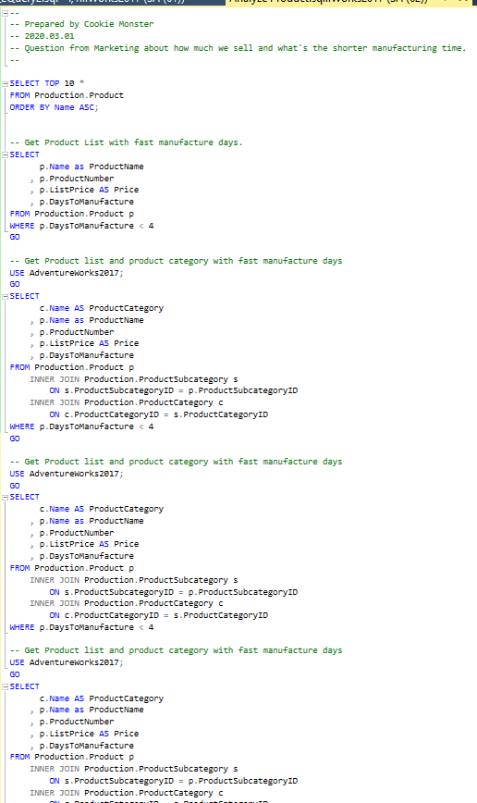
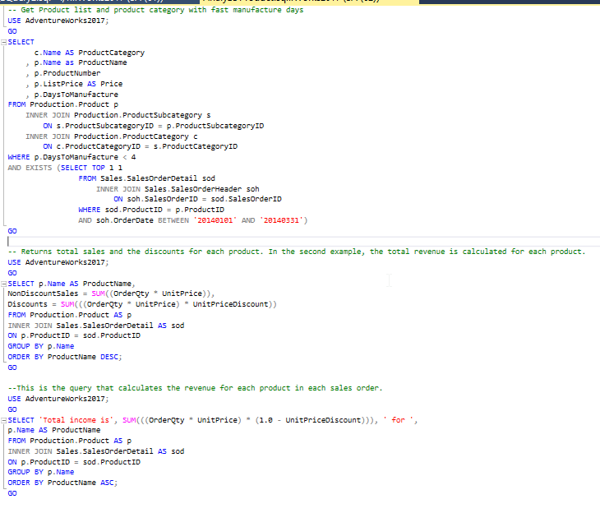
My dirty little scripts in the closet ….

Slide 13

Many days later …

Slide 14

You know that list that you sent me last time about that fast manufacturer… Can refresh it, please?
PANIC
PANIC
PANIC
What list?
PANIC
Oh.. That list! Yea yea…
Here you go again…
PANIC
I want to compare what the result back then and what it is now; if we have had any changes…
PANIC
PANIC
Was the logic the same as what you did last time?
PANIC
Hello?
PANIC

Slide 15

Jenga
what’s the problem?
with your SQL scripts?

Slide 16


Lack of:
Reproducibility
Code Review
Auditing results / analysis
Context
Executable
Must haves:
Code
Documentation
Results
Visualization
Analysis + Interpretation
Executable

Slide 17
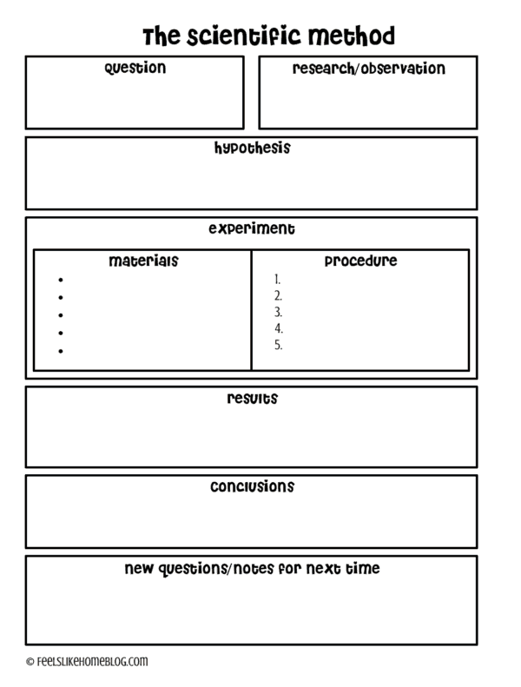

remember School Science Projects?
Source: https://feelslikehomeblog.com/2017/07/the-science-of-slime-its-way-more-than-polymers/

Slide 18

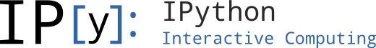
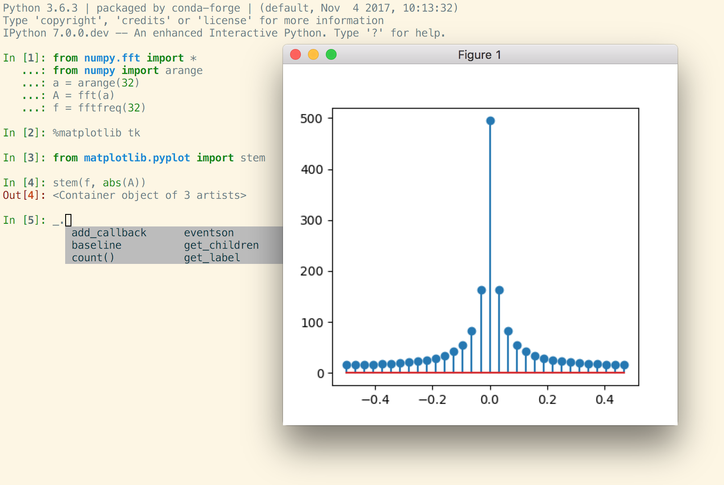

Mostly for Data Science projects
Open Source, open-standards and services for interactive computing for multiple languages – formed in 2015
Command shell for interactive computing – since 2001
Azure Databricks
Azure Notebooks*
VSCode
Azure Data Studio introduced notebooks in 2018 for Data professionals; and specifically for SQL People since 2019
Notebooks Journey

Slide 19

2. notebooks in
azure data studio
Notes:
Demo:
Basic Notebooks
Reproducible Research
Templates

Slide 20
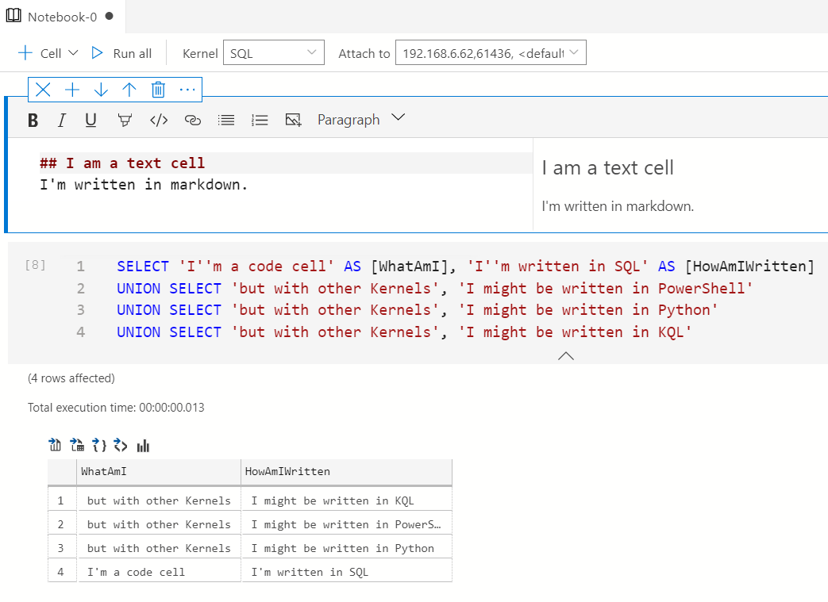
Notebooks
Text cells
Code cells
SQL
PowerShell
Python
KQL
.NET interactive
Notes:
JULIE

Slide 21


Lack of:
Reproducibility
Code Review
Auditing results / analysis
Context
Executable
Must haves:
Code
Documentation
Results
Visualization
Analysis + Interpretation
Executable
remember this?
Notes:
Remind attendees that they have seen these …
Basic Notebooks
Reproducible Research
Templates
But is that all?

Slide 22
Notebook Use Cases
Notebook as UX
Deployment
Troubleshooting
Notebooks as Documentation
Documentation
Education, Blogging
Feature Discovery
Notebooks for Data Workflows
ML Notebooks
Data Science
Data Engineering
Operational Notebooks
Execute as Job, Testing
Command Line Execution
Incident Response Workflow
Notebooks for Collaboration
Collaboration
Reporting
Data Viz
Notes:
These are what we (SQL Tools & Experiences team) are envisioning Notebooks.

Slide 23

Jump start with your existing scripts
SQL scripts to Notebook: ConvertTo-SqlNotebook
Powershell scripts to Notebook: ConvertTo-PowerShellNoteBook
https://github.com/dfinke/PowerShellNotebook
Notes:
Demo:
Convert SQL to notebooks, Convert PowerShell to Notebooks
Packaging Jupyter Book to Git.
Opening Jupyter Book in ADS.
Packaging notebooks as an extension or a remote book -> Only show an example on what the shipped version looks like.

Slide 24
Notebook Development and Sharing
Write Notebooks in Azure Data Studio
Troubleshooting Guide template
Bundle and organize your notebooks as Jupyter Books
Use source control – e.g. GitHub, Azure DevOps
Ship it!
For external facing use GitHub release features, example: https://github.com/MsSQLGirl/jubilant-data-wizards/releases/tag/v0.0.0
Ship as an Azure Data Studio extension to launch a Jupyter Book
Integrate with your incident response system
Ensure troubleshooting notebooks are evaluated and fixed during post-mortem
Watch for novel incidents with missing notebooks
New features should be accompanied with troubleshooting notebooks

Slide 25







Incident Response Flow & Ecosystem
System Event / User Reported Incident
Use existing notebooks
Create new notebooks
Add reusable notebook
Rate existing notebooks
Log adhoc notebook in incident system
Update notebook if necessary
Automate
Incident Response System
Investigate & Mitigate
Use Notebook as the incident’s audit trail
Post Mortem
Analyze and enrich Troubleshooting Repo
Troubleshooting Notebook Repo
Notes:
JULIE

Slide 26

3. learn more …

Slide 27
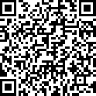
resources
http://aka.ms/AzureDataStudio | Sample files: https://bit.ly/2YGTpAy
SQL Assessment API notebook
https://github.com/microsoft/sql-server-samples/tree/master/samples/manage/sql-assessment-api/notebooks
Glenn Berry’s Diagnostic Notebooks for SQL Server and Azure SQL DB:
https://glennsqlperformance.com/resources/
Rob Sewell’s Notebook
http://sqldbawithabeard.com
Sample notebooks: https://github.com/SQLDBAWithABeard/JupyterNotebooks
The SQL Diagnostic (Jupyter) Book by Emanuele Meazzo
https://tsql.tech/the-sql-diagnostic-jupyter-book/

Slide 28

4. give it a go!

Slide 29
Key take-aways
Notebooks for SQL people use cases
Reproducible research, aka. Data analysis and data exploration.
Troubleshooting guides for incident response
Tutorial / How-to’s
Data Engineering
Deployment
Language (Kernel) supported in Azure Data Studio:
SQL
PowerShell
Python
PySpark
Spark Scala
Spark R
.net interactive
Try it out today: http://aka.ms/getAzureDataStudio

Slide 30
Want to provide feedback on the presentation?
https://www.surveymonkey.com/r/PSKT9VC

Slide 31
thank you!
Julie Koesmarno (@MsSQLGirl)
Program Manager, Microsoft
jukoesma@microsoft.com

